Slide 2
ОПРОС
https://docs.google.com/forms/d/1Rkb5kzdZwLNb8h2bSdoahbRm_03X_oqhtYZp1qfhCGQ/edit

Slide 9
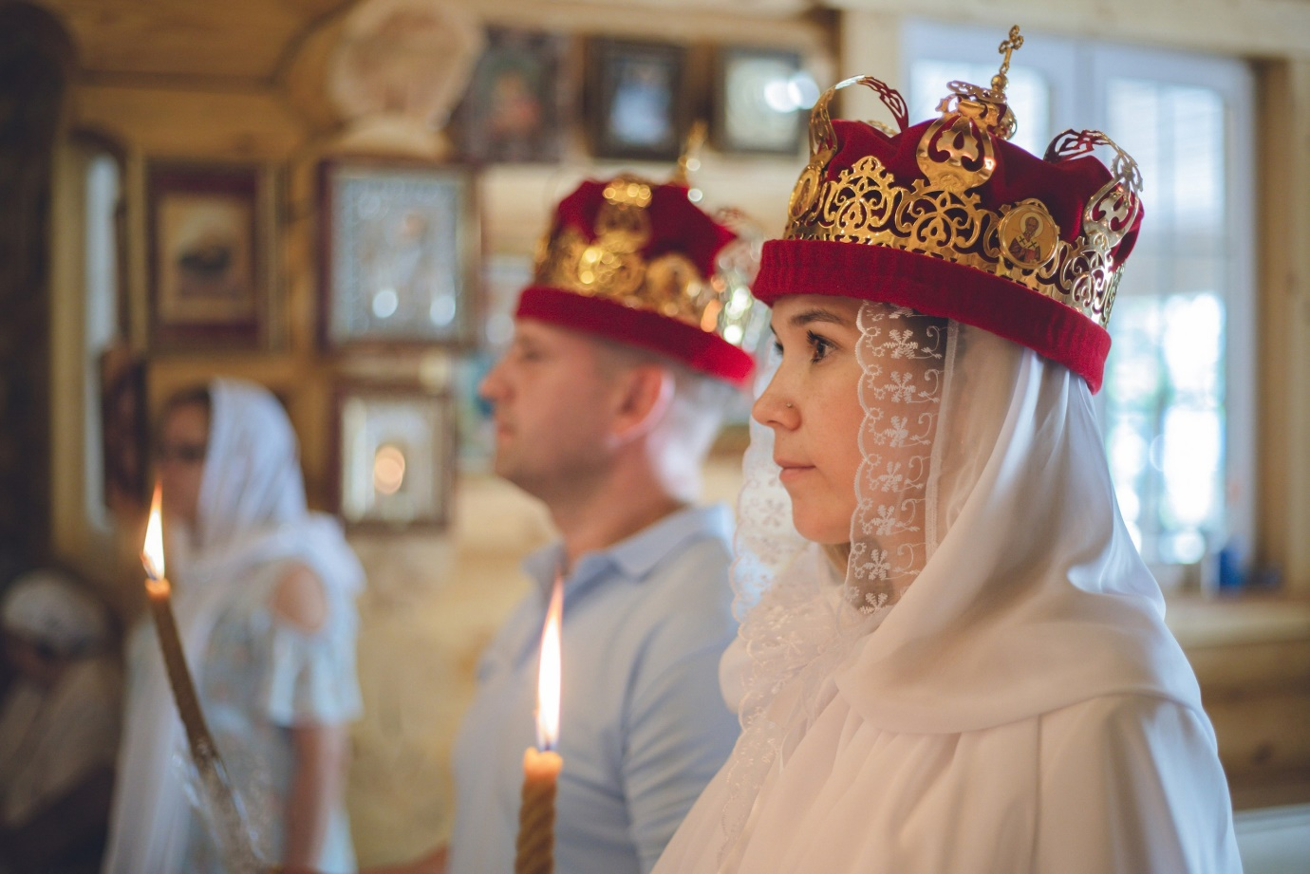

Slide 10
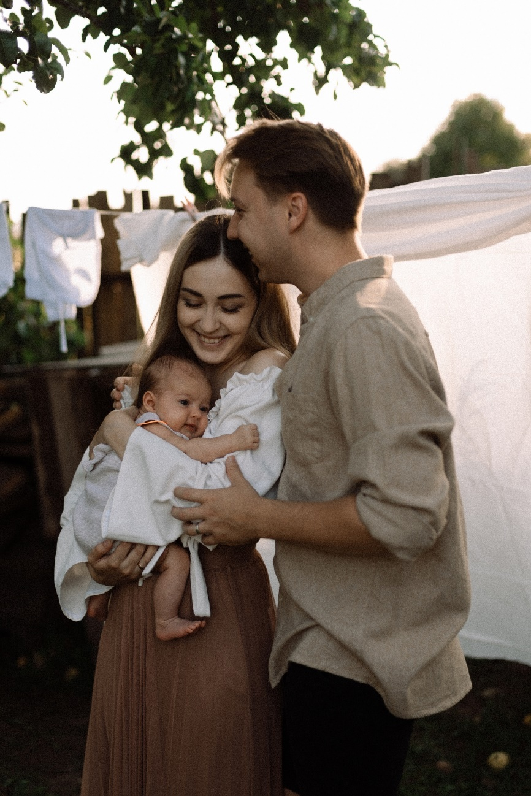

Slide 14
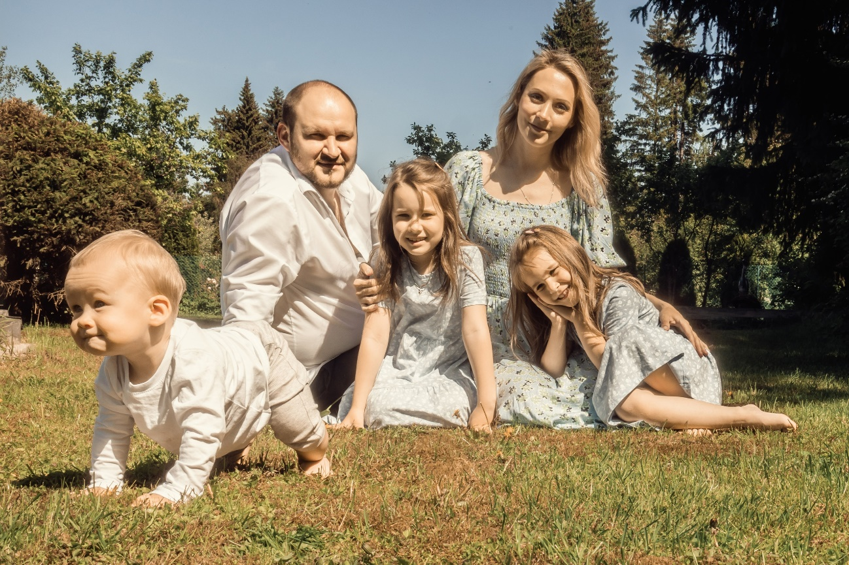

Slide 15
